Slide 1
BIT304 – Final Project I Ayo Magang : Web Application for Internship in Denpasar
Rivaldo Bagus Soepardhy (E1700882)
Luh Wulandari Maharani (E1700873)

Slide 2
Project Background
In the current era of digitalization, the public, especially vocational high school and college students, want ease in accessing various information, one of them is accessing information on internships. Where vocational high school or college students who have just a little or even no relations, still can find the right internship easily.
Ayo Magang is a web-based apprenticeship application created specifically to facilitate vocational high school and college students to find internships around Denpasar city, which are desired according to their field of expertise. Companies and related institutions will find the desired employees easily and can save on expenses.

Slide 3
Project Aims
The aim of this project is to develop an application for vocational high school and college students to find internship in companies for academic purpose. This also ease companies to get interns to work in their company for the sake of educational purpose or even company’s branding. This application helps student to find the desired company for internship in order to fulfil the demand of their school’s or campus’s academic. This application can also determined which company to get along with according to the course of your education stated in your profile (Hospitality, Technology, Medical etc.).
It is expected from this application that this could help student in trouble or confusing situation to consider which workplace will be a good place for their internship, while also helping companies to get better branding and to find potential employee through the internship.

Slide 4
Project Objectives
Providing information for vocational high school and college student about relatable workplace for their academic internship.
Providing a media for company to have company branding (advertisement).
Providing a media for company indirectly to recruit and train potential prospective employees from the internship.
Providing an indirect potential relationship between both educational institutes and companies.
Providing real evidence to support increased of investment in human resource, marketing, and technology.

Slide 5
Hardware Requirements
No | Item | Usability | Qty | Cost
1 | Asus VivoBook S14-410UN | Project Development & Project Testing | 1 | Available
2 | Asus ROG GL503GE | Project Development & Project Testing | 1 | Available
3 | Canon G2010 | Document Printing | 1 | Available

Slide 6
Software Requirements
No | Item | Usability | Qty | Cost
1 | Adobe XD CC 7.0.12.9 | Create interface design | - | Available
2 | Microsoft Visio 2016 | Drawing UML Diagram | - | Available
3 | Microsoft Word 2016 | Create project document | - | Available
4 | Microsoft PowerPoint 2016 | Create presentation for the project | - | Available
5 | XAMPP 7.4.3-0 | Database Creation, Project Development, Project Testing. | - | Available
6 | Gantt Project 2.8.1 | Create project schedule | - | Available
7 | Brackets | Project Development | - | Available

Slide 7
Literature Review
Internship (intern) is the position of a student or trainee who works in an organization, sometimes without pay, in order to gain work experience or satisfy requirements for a qualification.
Academic Internship help intern (student) to experience real work in the field for the sake of gaining experience and balancing between both theory and practice
Due to limited exposure and confusion between job internship and academic internship, it will be very hard time for student to find companies for their academic internship exercise.

Slide 8
Current Practice
Still using Conventional search (offline media, networking, advertisement, recommendation, etc.)
Networking, not helping enough for low soft-skill or low networking student
Confusion between internship for real job and academic internship
Companies not having enough exposure for providing academic internship

Slide 9
Similar Application

Slide 10
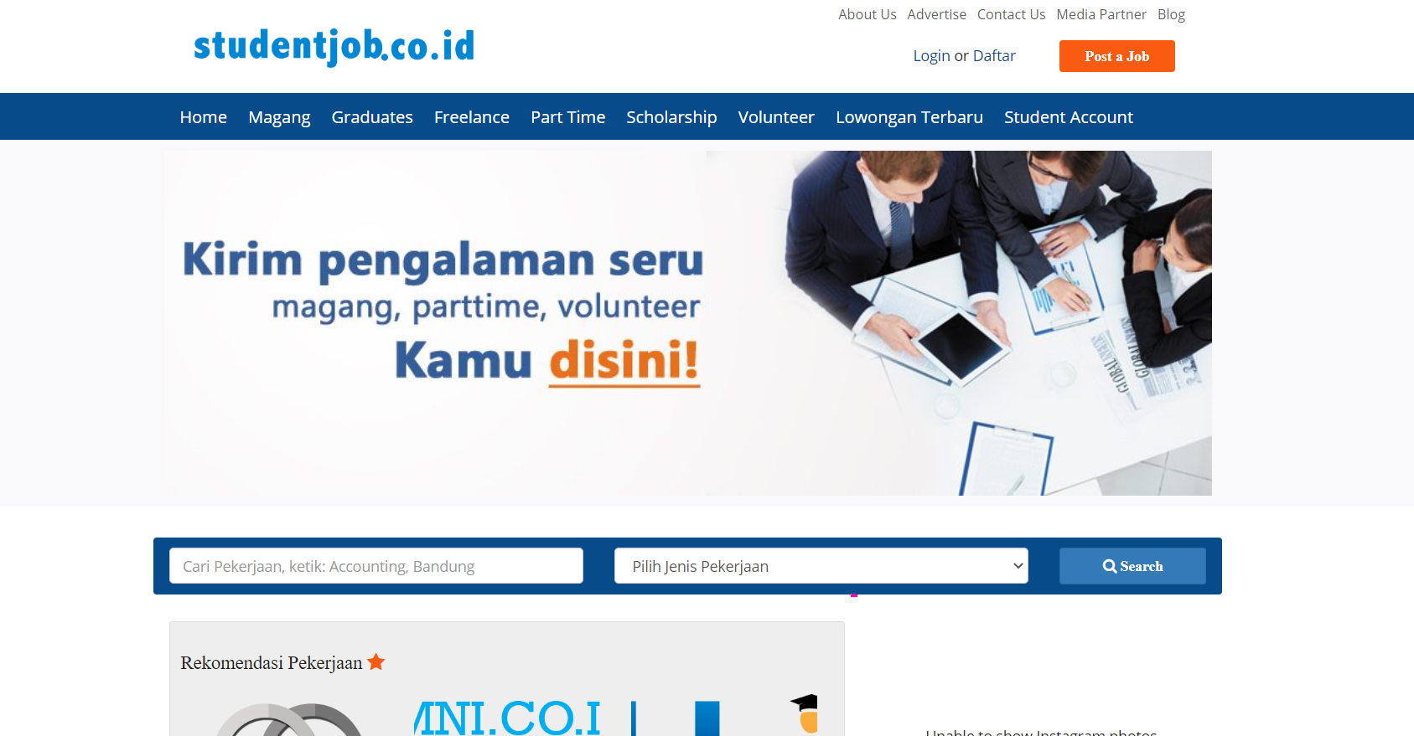
Similar Application

Slide 11
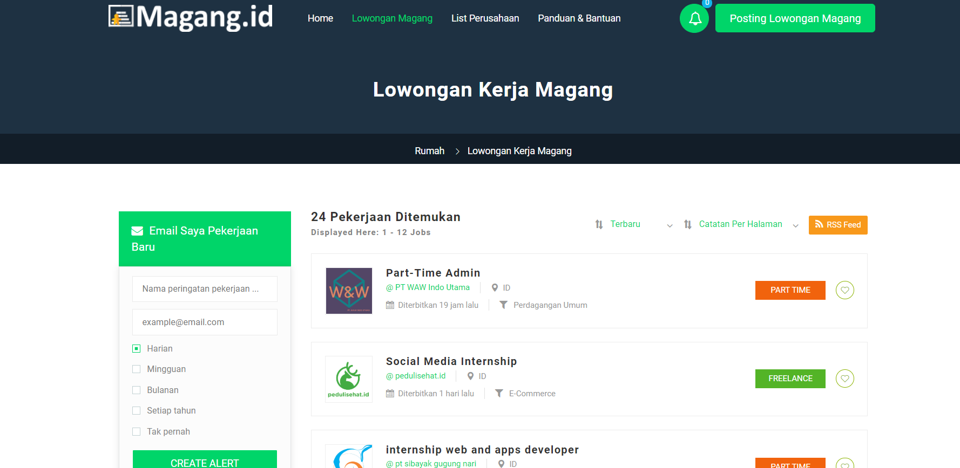
Similar Application

Slide 12
Challenges
Lack of experience in developing website in PHP
Lack of basic knowledge in programming and security
Design a friendly and responsive design website

Slide 13
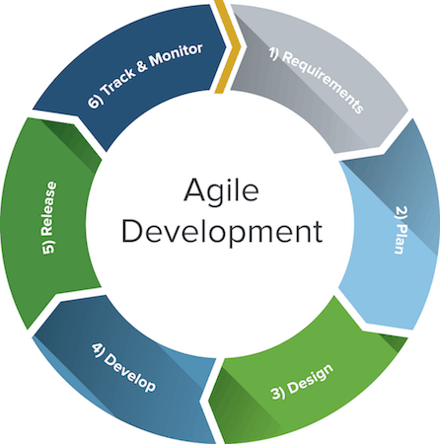
Methodology
Agile Methodology suits our needs and condition. The scalability and flexibility of Scrum Framework helps us to adapt on sudden time changes, fundamental changes on system or graphics design. The methodology also focuses on teamwork, means supports & collaboration between member is important and critical.
Developers and testers can work together (end user and developer), allowing for more input for the better of the development.

Slide 14
GANTT CHART

Slide 15
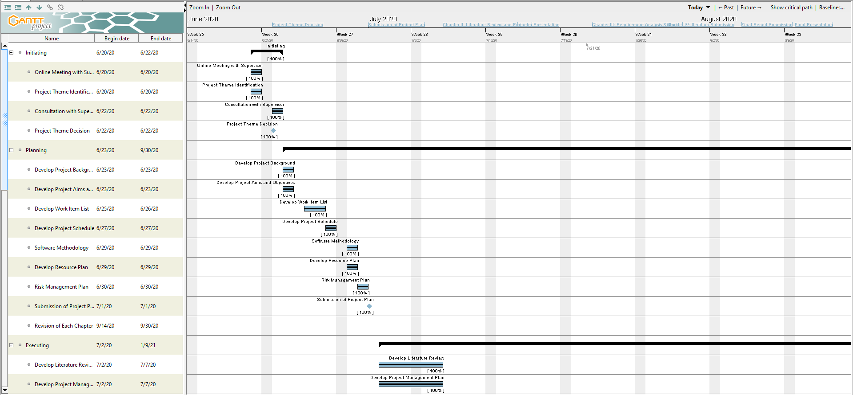
1

Slide 16
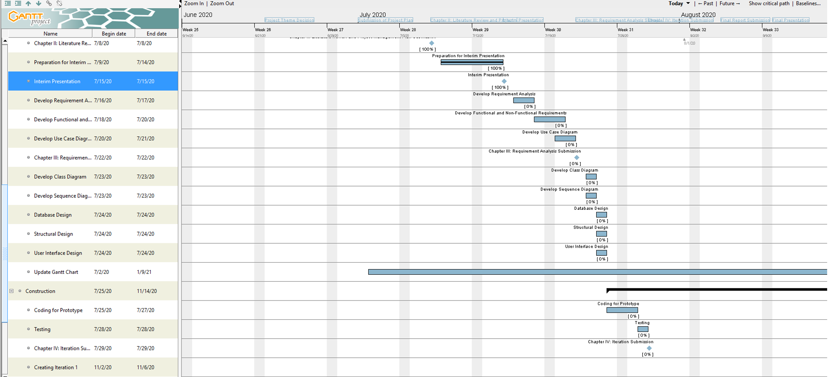
2

Slide 17
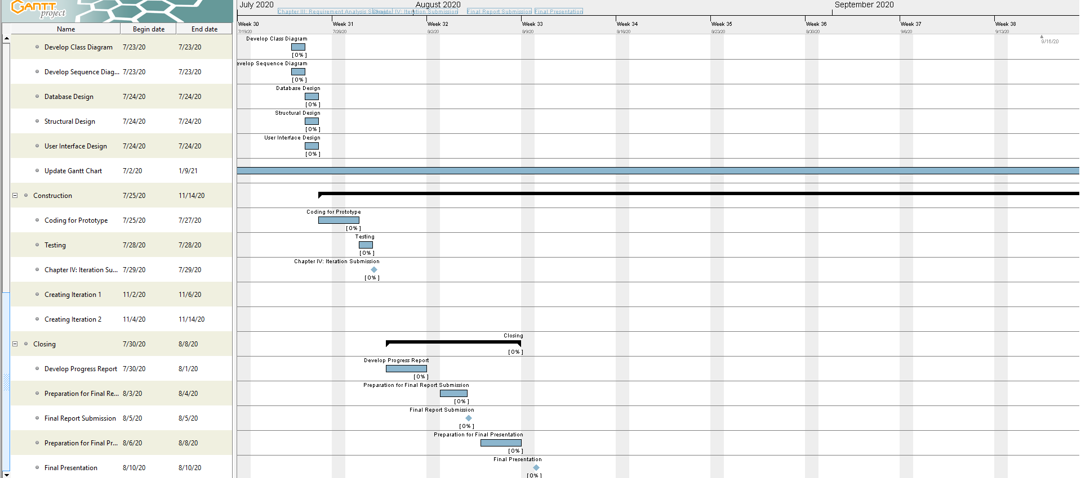
3

Slide 18
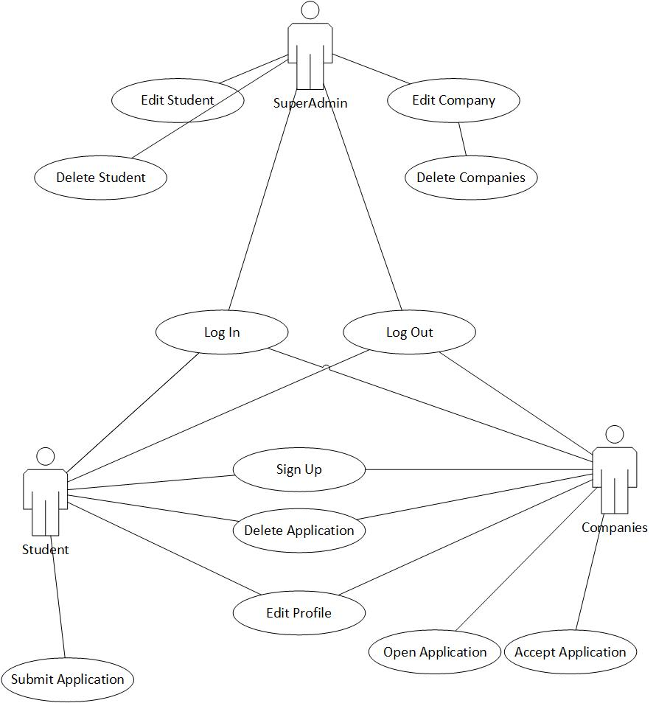
USE CASE DIAGRAM

Slide 19




Deliverables
Project Plan
Project Management Plan
Literature Review
Simple Prototype

Slide 20
HIGHLIGHT OF PROTOTYPE

Slide 21
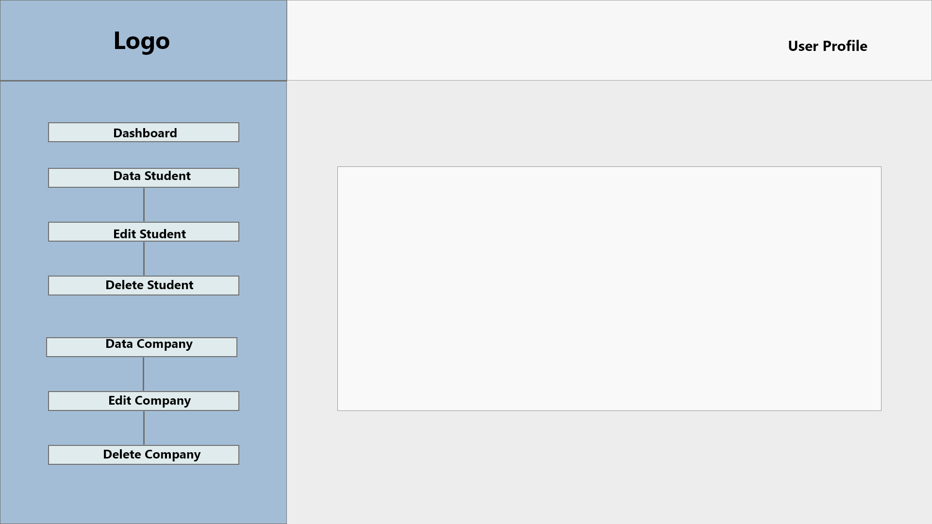
Actor : Super Admin

Slide 22
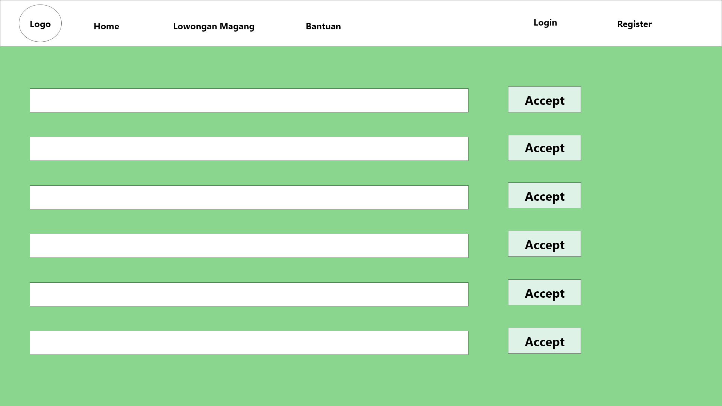
Actor : Company

Slide 23
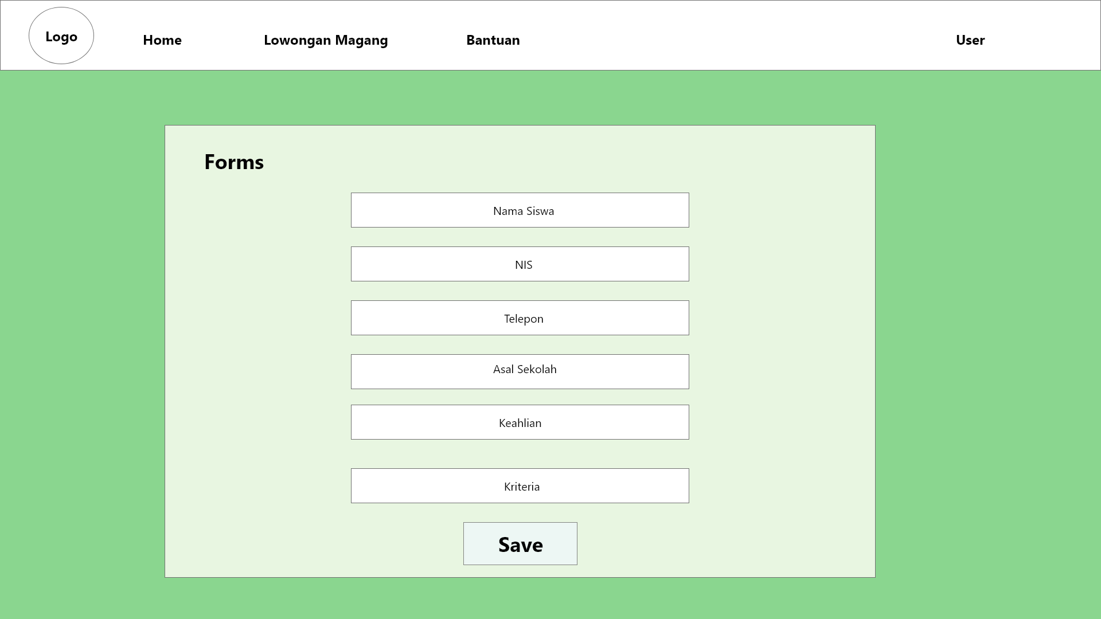
Actor : Student

Slide 24
Another Work to Achieve
Real working Prototype of the system application
Final documentation

Slide 25
Thank You!

